Slide 1


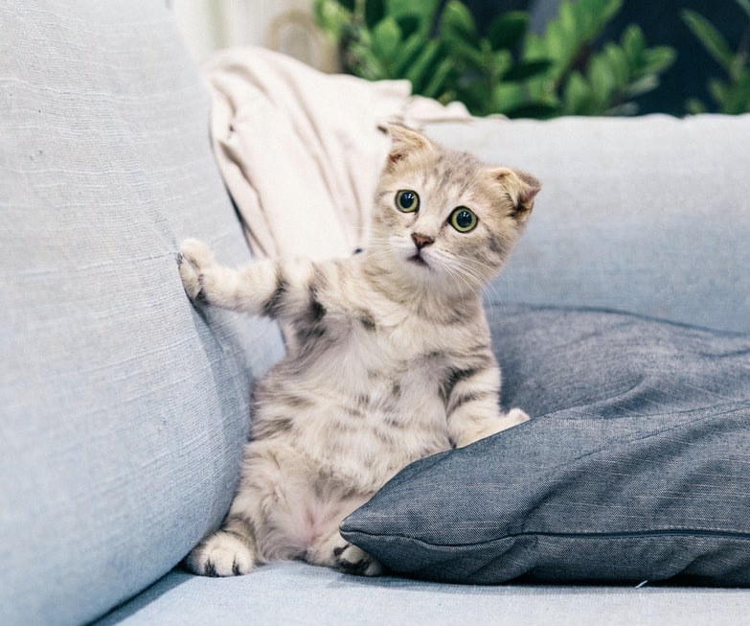
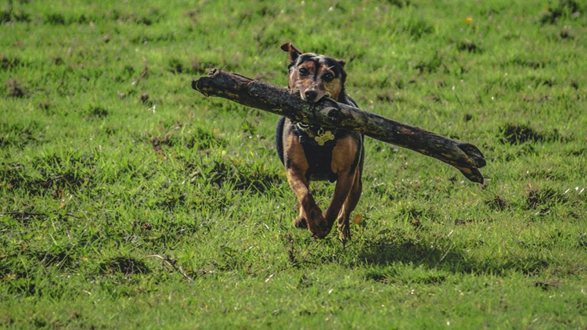
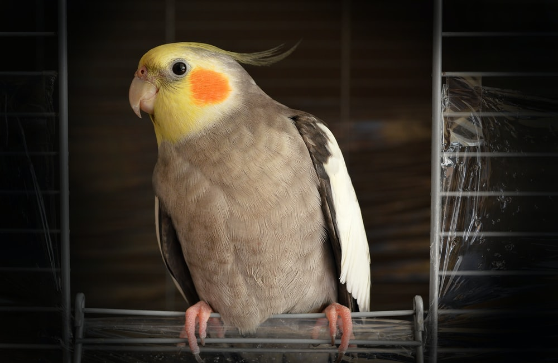

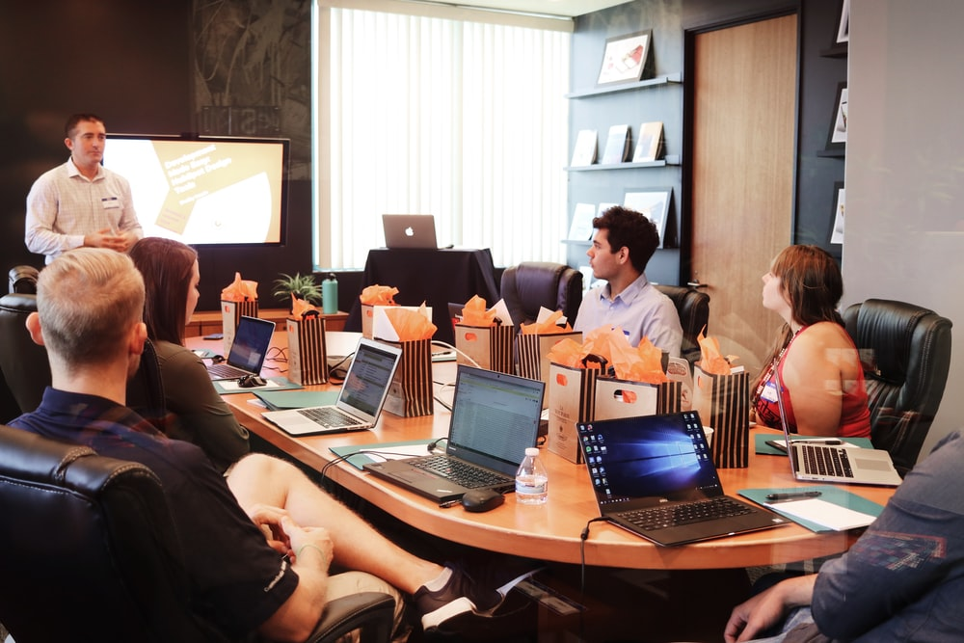
REQUEST A CONSULTATION
search this site
Fetch
“Evidence-based pet care advice for every pet lover”
HOME
CAT OWNERS
DOG OWNERS
BIRD OWNERS
CONTACT FORM
Paradigm Pet Professionals
Pets are nature's gift to humanity. It has been scientifically proven that opening our homes and hearts to a pet increases our longevity and improves our overall quality of life as well as the lives of our pets. At Pet Paradigm Professionals, our mission is to offer resources to help you care for your furry, scaly, feathery, and slimy loved ones. Our pet experts—or “Pexperts”—have been working with pet owners and professionals alike for the past twelve years. They offer one-on-one consultations with current and prospective pet owners as well as group presentations designed for veterinary, pet shelter, and pet breeding professionals.
Looking for basic pet care advice for the most common type of pets? Need additional help determining which type of pet is right for you and your family? We will work with you and provide tailored evidence-based pet care to ensure lifelong health and wellness of your new companion.
Looking for your new best friend? The following organizations can help you find and adopt the perfect companion:
General Adoption Resources
ASPCA
Fish Rescue
Snake Rescue
Bird Rescue
We are also happy to help you navigate the adoption process! We will guide you through each step in the process from determining which type of pet is best suited for your family and home environment, to completing the necessary paperwork, to bringing your new loved one home. Please fill out our contact form to request a consultation. We will contact you within 48 hours to schedule a consultation. All fields are required.
Nourishment for Cats
Physical Activity for Dogs
Bird Relational Needs
About Paradigm Pet Professionals
“Evidence-based pet care advice for every pet lover”
Paradigm Pet Professionals has twelve years’ experience working with pet owners, certifications in pet health and nutrition, and customer recognition for outstanding support.
We provide virtual consultations and presentations, one-on-one consultations concerning individual pets, and group presentations regarding general pet care that are tailored to the needs of the group.
REQUEST A CONSULTATION
Pexpert Team Meeting
Paradigm Pet Professionals has 12 years’ experience working with pet owners and has been recognized for outstand support. Our certified pet health and nutrition consultants would love to work with you.
© 2022 Paradigm Pet Professionals
Request a Consultation
Notes:
HOME

Slide 2
REQUEST A CONSULTATION
search this site
Fetch
“Evidence-based pet care advice for every pet lover”
HOME
CAT OWNERS
DOG OWNERS
BIRD OWNERS
CONTACT FORM
Caring for Your Cat
Paradigm Pet Professionals has 12 years’ experience working with pet owners and has been recognized for outstand support. Our certified pet health and nutrition consultants would love to work with you.
© 2022 Paradigm Pet Professionals
Request a Consultation
Notes:
CATS

Slide 3
REQUEST A CONSULTATION
search this site
Fetch
“Evidence-based pet care advice for every pet lover”
HOME
CAT OWNERS
DOG OWNERS
BIRD OWNERS
CONTACT FORM
Caring for Your Dog
Paradigm Pet Professionals has 12 years’ experience working with pet owners and has been recognized for outstand support. Our certified pet health and nutrition consultants would love to work with you.
© 2022 Paradigm Pet Professionals
Request a Consultation
Notes:
DOGS

Slide 4
REQUEST A CONSULTATION
search this site
Fetch
“Evidence-based pet care advice for every pet lover”
HOME
CAT OWNERS
DOG OWNERS
BIRD OWNERS
CONTACT FORM
Caring for Your Bird
Paradigm Pet Professionals has 12 years’ experience working with pet owners and has been recognized for outstand support. Our certified pet health and nutrition consultants would love to work with you.
© 2022 Paradigm Pet Professionals
Request a Consultation

Slide 5
REQUEST A CONSULTATION
search this site
Fetch
“Evidence-based pet care advice for every pet lover”
HOME
CAT OWNERS
DOG OWNERS
BIRD OWNERS
CONTACT FORM
Contact Form
Your Information
YOUR NAME
PHONE NUMBER
EMAIL ADDRESS
TIME ZONE
Pet’s Information
PET’S NAME
ANIMAL TYPE
PET’S AGE
SUBMIT YOUR REQUEST
Paradigm Pet Professionals has 12 years’ experience working with pet owners and has been recognized for outstand support. Our certified pet health and nutrition consultants would love to work with you.
© 2022 Paradigm Pet Professionals
Request a Consultation
Notes:
FORM

